Slide 1
A Spreadsheet Program for Use in the Detection of Anomalous Numerical Data of the Type Frequently Encountered in Cell and Radiation Biology Colony Survivals
Helene Z Hill
Rutgers NJ Medical School, Newark, NJ
And
Joel Pitt
Renaissance Associates, Princeton, NJ
Radiation Research Society Annual Meeting
September, 2014

Slide 2
Scientific Misconduct
Falsification, Fabrication, Plagiarism
How much is there?
Who does it?
How much does it cost?
What to do about it?

Slide 3
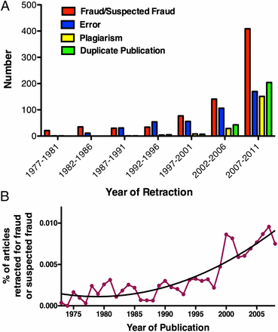
Misconduct accounts for the majority of retracted scientific publications PNAS 109: 17028 (2012)
F.C. Fang, R.G. Steen, and
A. Casadevall
Fanelli D (2009) How Many Scientists Fabricate and Falsify Research? A Systematic Review and Meta-Analysis of Survey Data. PLoS ONE 4(5): e5738. doi:10.1371/journal.pone.0005738
“A pooled weighted average of 1.97% (N = 7, 95%CI: 0.86–4.45) of scientists admitted to have fabricated, falsified or modified data or results at least once –a serious form of misconduct by any standard– and up to 33.7% admitted other questionable research practices. In surveys asking about the behaviour of colleagues, admission rates were 14.12% (N = 12, 95% CI: 9.91–19.72) for falsification, and up to 72% for other questionable research practices. “
“…misconduct was reported more frequently by medical/pharmacological researchers than others.”
3

Slide 4
The Costs of Research Misconduct
From the Ithenticate^{R} website
2002: 1.09m journal articles published annually
2010: 1.94m journal articles published annually
7,000,000 researchers/ca 32,000 scholarly journals
23% of submissions to one leading scholarly journal rejected for plagiarism
Types of damage
  job losses, revoked PhDs and awards, damaged reputations, retractions
  Est cost of single investigation in US $525,000
  ca 71,000 patients treated in ca 900 retracted studies
  $110,000,000 Total cost of investigations into research misconduct in US in 2010

Slide 5
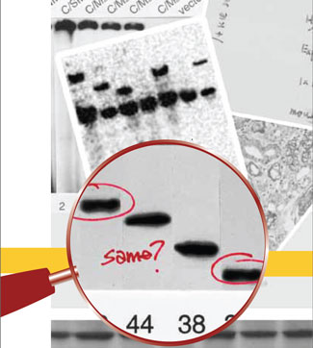
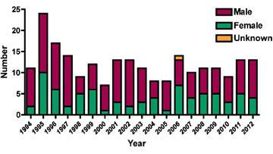
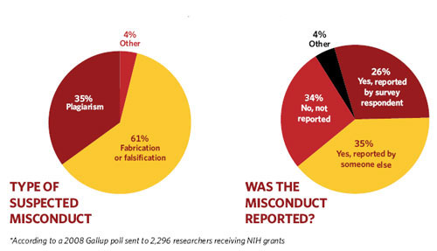
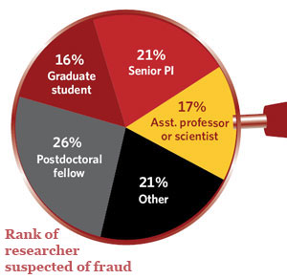
A Gawrylewski Fixing Fraud The Scientist 23: 67 (2009)
Men commit more misconduct than women Williams, SCP Biotechniques 1/23/2013
Images are the easiest to spot

Slide 6

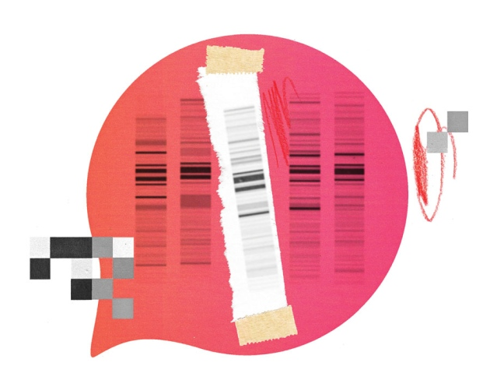



Research ethics: 3 ways to blow the whistle
Reporting suspicions of scientific fraud is rarely easy, but some paths are more effective than others.
Ed Yong,
Heidi Ledford
& Richard Van Noorden
27 November 2013
Article tools
PDF
Rights & Permissions
The Analytical
The Anonymous
The Quixotic

Slide 7
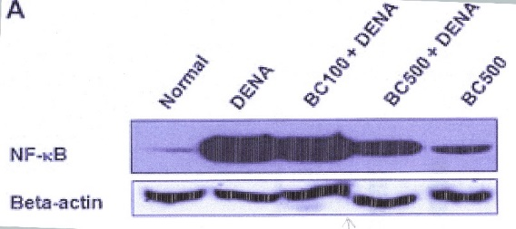
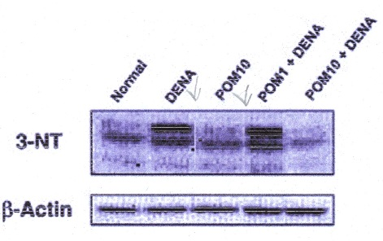
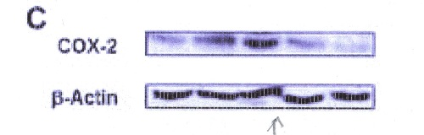
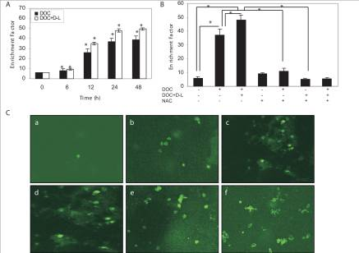
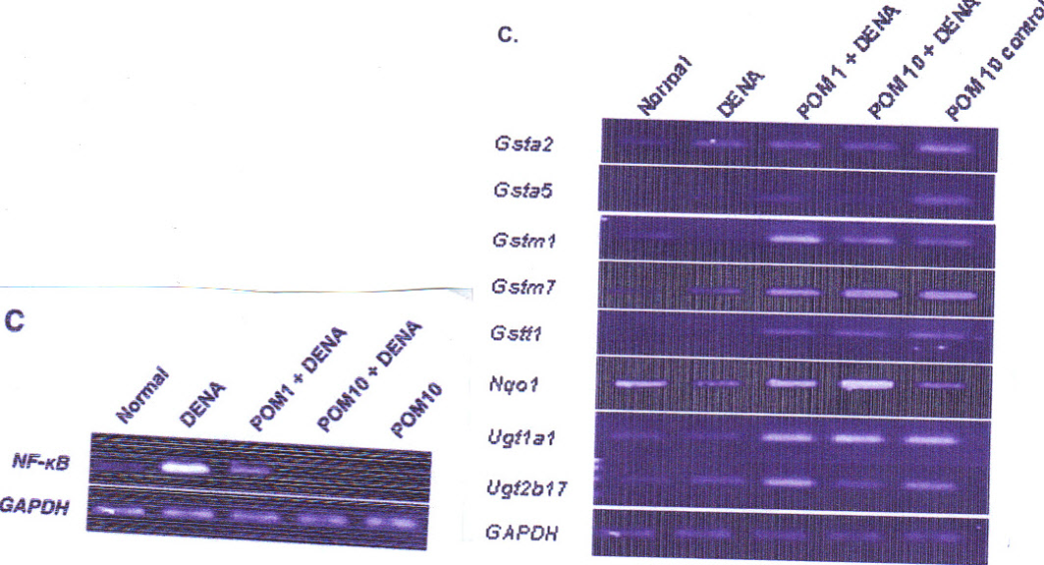
Image Manipulations
3NT: Sharp vertical lines between lanes 2/3 and 3/4, background change lane 4 versus lanes 3 and 5. Possible figure manipulation
Beta-actin: large vertical steps between bands in lanes 3 and 4 versus cox-2 and NF-κB: no vertical step between bands 3 and 4: unlikely these are from the same blot
Carcinogenesis (2011) 32: 888-896
Data Reuse: same GAPDH in 2 different studies
Timed Series of Micrographs
J. Nutr Biochem (2013) 24: 178-187
d is stretched copy of c

Slide 8
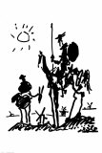
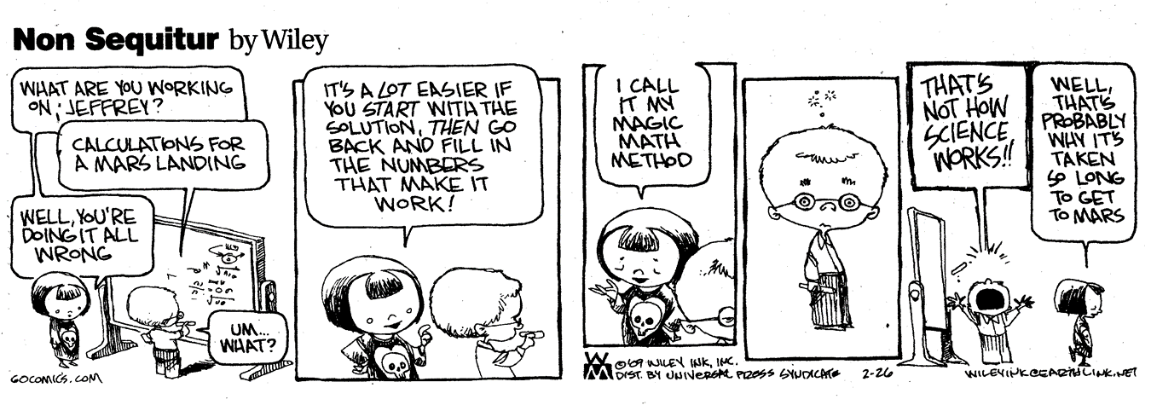
Statistical Sleuthing:
Helene Z Hill: the quixotic whistleblower and Joel Pitt = Sancho Panza (the numbers guy)

Slide 9
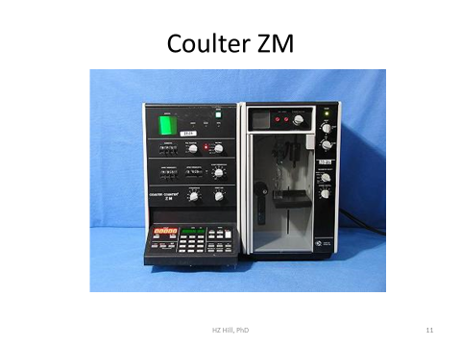
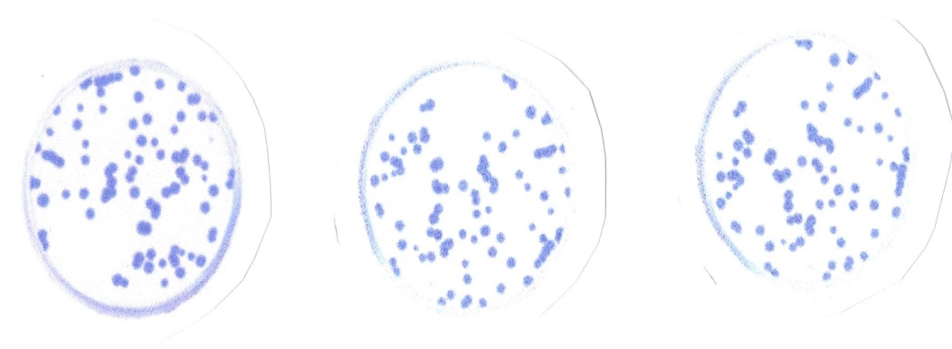
Data Sets:
Colony Counts in triplicate
Cell Counts (not necessarily in triplicate)

Slide 10
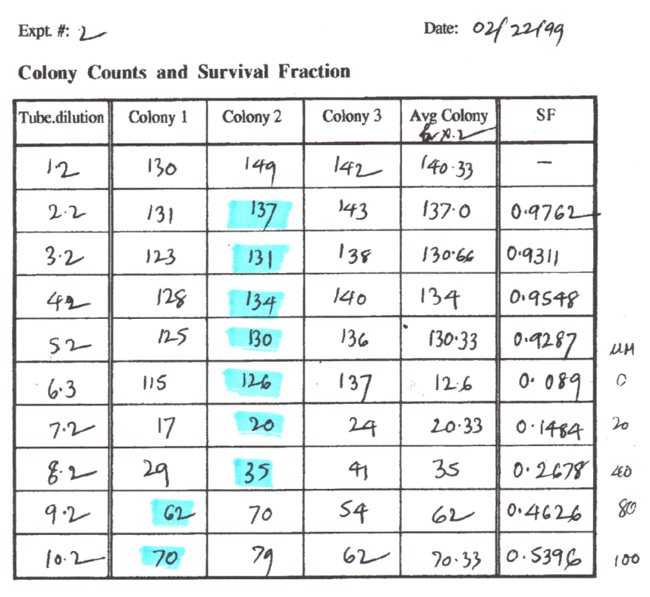
In the triplicate colony counts of one member of the laboratory, an unusually high number of triples contained the rounded mean. This gave rise to the concept of the Mid Ratio
Mid-Ratio Distributions
The Mid-Ratio
We compared the pooled mid-ratio distributions of colony triples of 9 members of the laboratory (Controls) with the distribution of the questioned member (Test Case)
Mid Ratio: (mid-lo)/(hi-lo)
Sample Experiment
Mid R
0.63
0.50
0.53
0.50
0.45
0.50
0.43
0.50
0.50
0.47

Slide 11
The Spreadsheet
Test Case: Colony Counts
Data are captured from a second spreadsheet – identified by column and row – here hi-lighted in yellow (T, test data; C, Controls).
Test #1 (outlined in red): The number of rounded averages per triplicate sample are counted and compared to the expected number based on the Pitt model that calculates the probability that the data set will contain that many or more mean-containing triples. The mid-ratio distribution for the data set is also calculated and graphed.
Data Set:

Slide 12
Test Case: Coulter Counts
The Spreadsheet
Test 2: Terminal digits are quantified by integer. Their distribution is compared to a uniform distribution of the same magnitude. The chi squared test is used to determine the probability that T’s test digits are uniformly distributed. The distribution and the graphic representation for T’s counts are outlined in green. NB the data sets are not necessarily in triples.
Test 3: The binomial probability for equal terminal digits in T’s counts is calculated compared to the expectation of 0.10 – outlined in purple.
Sample # | T Triplicate Counts |  |  | C Triplicate Counts
1 | 577 | 592 | 563 | 89 | 97 | 86
2 | 611 | 607 | 653 | 331 | 316 | 329
3 | 581 | 593 | 617 | 378 | 330 | 375
4 | 633 | 645 | 619 | 333 | 404 | 367
5 | 511 | 537 | 549 | 396 | 382 | 408
6 | 544 | 562 | 573 | 342 | 331 | 344
7 | 666 | 672 | 693 | 340 | 349 | 344
8 | 601 | 572 | 633 | 325 | 347 | 304
9 | 511 | 529 | 541 | 315 | 291 | 283
10 | 532 | 555 | 562 | 307 | 339 | 323
11 | 513 | 549 | 562 | 285 | 314 | 323
12 | 562 | 539 | 547 | 260 | 262 | 284
13 | 560 | 542 | 522 | 361 | 315 | 298
14 | 680 | 669 | 671 | 355 | 324 | 356
10 doubles p = 7.31 x 10⁻³
4 doubles p= 0.616

Slide 13
Terminal Digits and Doubles
Others
Test Case
The distribution of terminal digits in a data set of 2942 Coulter counts by Controls (p ~ 0.07 for uniform distribution)
Data set of 5155 Coulter counts by Test Case (p~0 for uniform distribution)
The distribution of terminal digits in a data set of 1814 colony counts by Controls (p~0.996 for uniform distribution)
Data set of 3501 colony counts by Test Case (p~0 for uniform distribution)
Note the similarity between the distributions in B and D

Slide 14
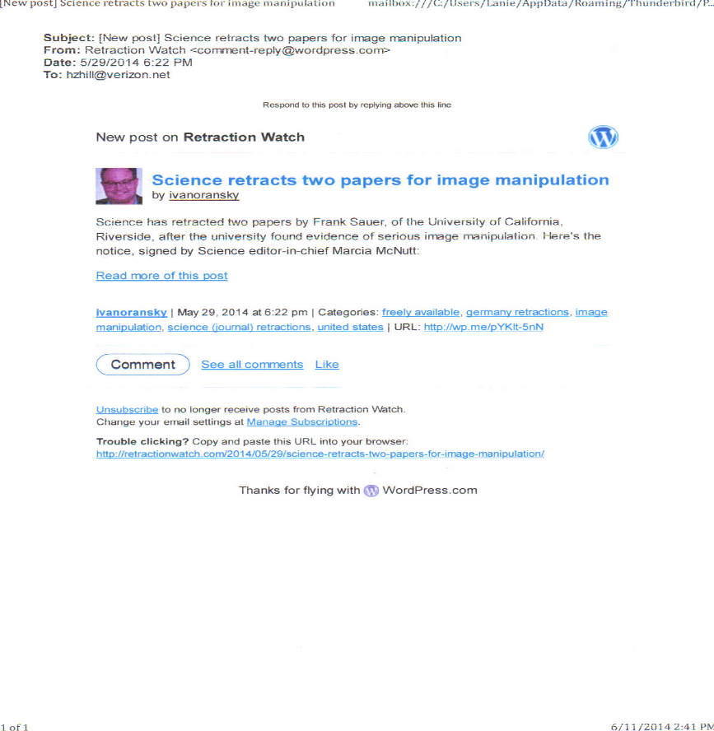
What’s To Do:
Retraction Watch
The Obligations for Journals
Run every submission through plagiarism testing
Require that complete images for gels be submitted for review
All raw data must be posted and publically accessible
Don’t be afraid of lawsuits ~ the truth is the best defense
Pub Peer Post Publication Review

Slide 15
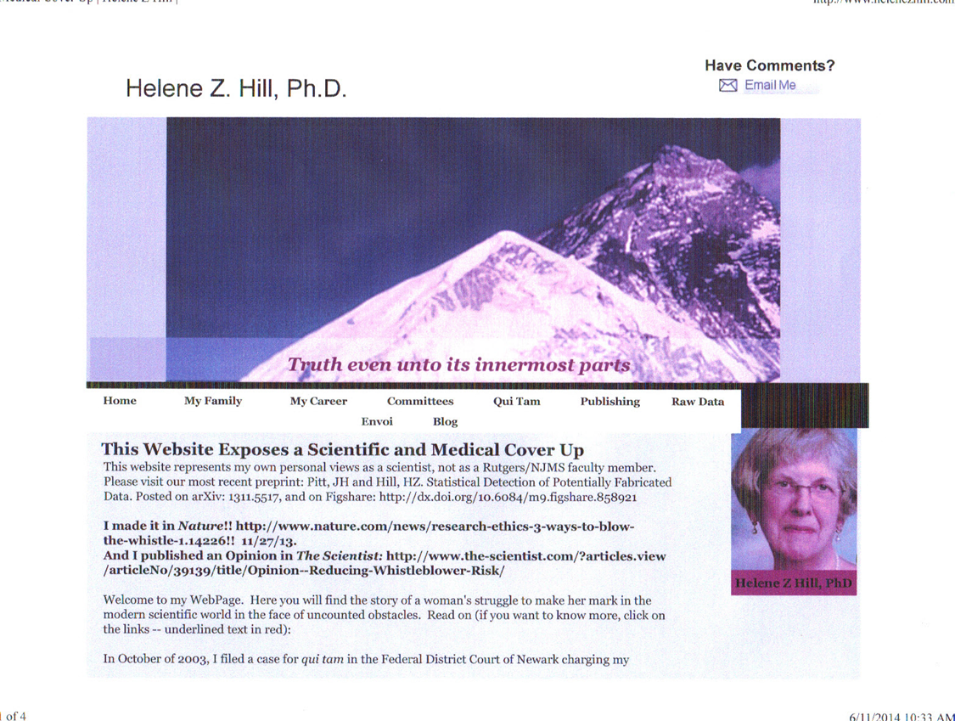

My Website: www.helenezhill.com
My Blog:
www.integritywatchforscienceandmedicine.com

Slide 16
Take One

